Slide 1
ANGULAr 2 components communication with events

Slide 2
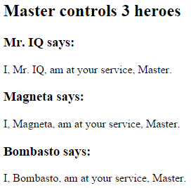
Pass data from parent to child with input binding
@Component({ selector: 'hero-child', template: `
<h3>{{hero.name}} says:</h3> <p>I, {{hero.name}}, am at
your service, {{masterName}}.</p>
` }) export class HeroChildComponent { @Input() hero: Hero; @Input('master') masterName: string; }
@Component({ selector: 'hero-parent', template: `
<hero-child *ngFor="let hero of heroes" [hero]="hero" [master]="master">
</hero-child>`
}) export class HeroParentComponent { heroes = HEROES; master: string = 'Master'; }
HeroParentComponent
HeroChildComponent
hero
master

Slide 3
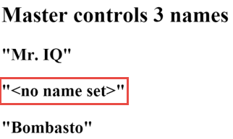
Intercept input property changes with a setter
@Component({ selector: 'name-child', template: '<h3>"{{name}}"</h3>' }) export class NameChildComponent { private _name = ''; @Input() set name(name: string) { this._name = (name && name.trim()) || '<no name set>'; } get name(): string { return this._name; } }

Slide 4
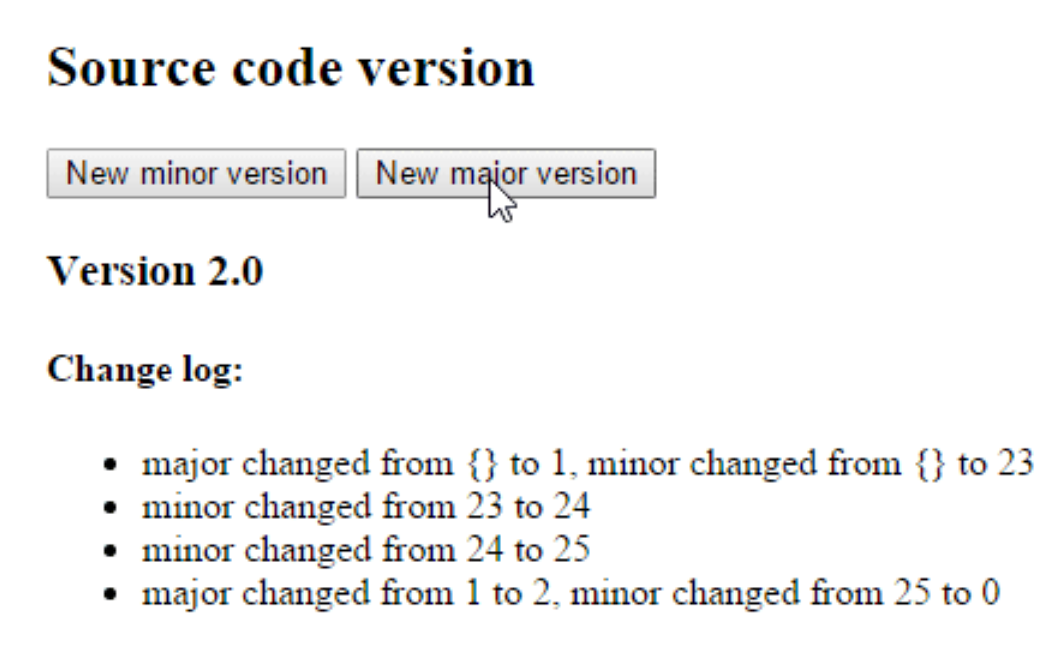
Intercept input property changes with ngOnChanges
@Component({ selector: 'version-parent', template: ` <h2>Source code version</h2> <button (click)="newMinor()"> New minor version </button> <button (click)="newMajor()"> New major version </button> <version-child [major]="major" [minor]="minor"> </version-child>` }) export class VersionParentComponent { major: number = 1; minor: number = 23; newMinor() { this.minor++; } newMajor() { this.major++; this.minor = 0; } }

Slide 5
Intercept input property changes with ngOnChanges
@Component({ selector: 'version-child', template: ` <h3>Version {{major}}.{{minor}}</h3> <h4>Change log:</h4> <ul><li *ngFor="let change of changeLog">{{change}}</li></ul>`}) export class VersionChildComponent implements OnChanges { @Input() major: number; @Input() minor: number; changeLog: string[] = []; ngOnChanges(changes: {[propKey: string]: SimpleChange}) { let log: string[] = []; for (let propName in changes) { let changedProp = changes[propName]; let from = JSON.stringify(changedProp.previousValue); let to = JSON.stringify(changedProp.currentValue); log.push( `${propName} changed from ${from} to ${to}`); } this.changeLog.push(log.join(', ')); } }

Slide 6
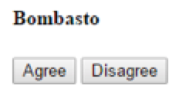
Parent listens for child event
@Component({ selector: 'my-voter', template: ` <h4>{{name}}</h4> <button (click)="vote(true)" [disabled]="voted">Agree</button> <button (click)="vote(false)" [disabled]="voted">Disagree</button> ` }) export class VoterComponent { @Input() name: string; @Output() onVoted = new EventEmitter<boolean>(); voted = false;
vote(agreed: boolean) { this.onVoted.emit(agreed); this.voted = true; } }

Slide 7
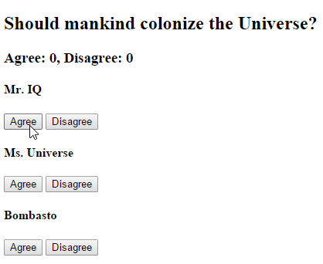
Parent listens for child event
@Component({ selector: 'vote-taker', template: ` <h2>Should mankind colonize the Universe?</h2> <h3>Agree: {{agreed}}, Disagree: {{disagreed}}</h3> <my-voter *ngFor="let voter of voters" [name]="voter" (onVoted)="onVoted($event)"> </my-voter> ` }) export class VoteTakerComponent { agreed = 0; disagreed = 0; voters = ['Mr. IQ', 'Ms. Universe', 'Bombasto']; onVoted(agreed: boolean) { agreed ? this.agreed++ : this.disagreed++; } }

